Slide 1
Sponsored is the New Organic: Implications of Sponsored Search Results in E-commerce Marketplaces
Kushagra Chitkara [19EE10036]
Arundhuti Naskar [19EE10009]
Rishitha Potnuru [19EE10047]
Pranav Khandka [19EE10048]
Somnath Banerjee [21CS91W06]

Slide 2
Motivation
Amazon: the biggest e-commerce marketplace (>12M Products, >30 categories, >200M unique visitor per Minute).
Sponsored recommendations offer a powerful option to platforms to explicitly steer customers toward (or away from) certain products.
Amazon Private Labels(PLs) enjoy a significantly high promotion in the sponsored recommendations.

Slide 3
Problem Statement
Are sponsored products getting overpromotion?
Position of Organic Search Results on Search Engine Result Page (SERP)?
Are PLs overpromoted?
Validating good/bad sponsored products.
Customer preference on sponsored products?

Slide 4
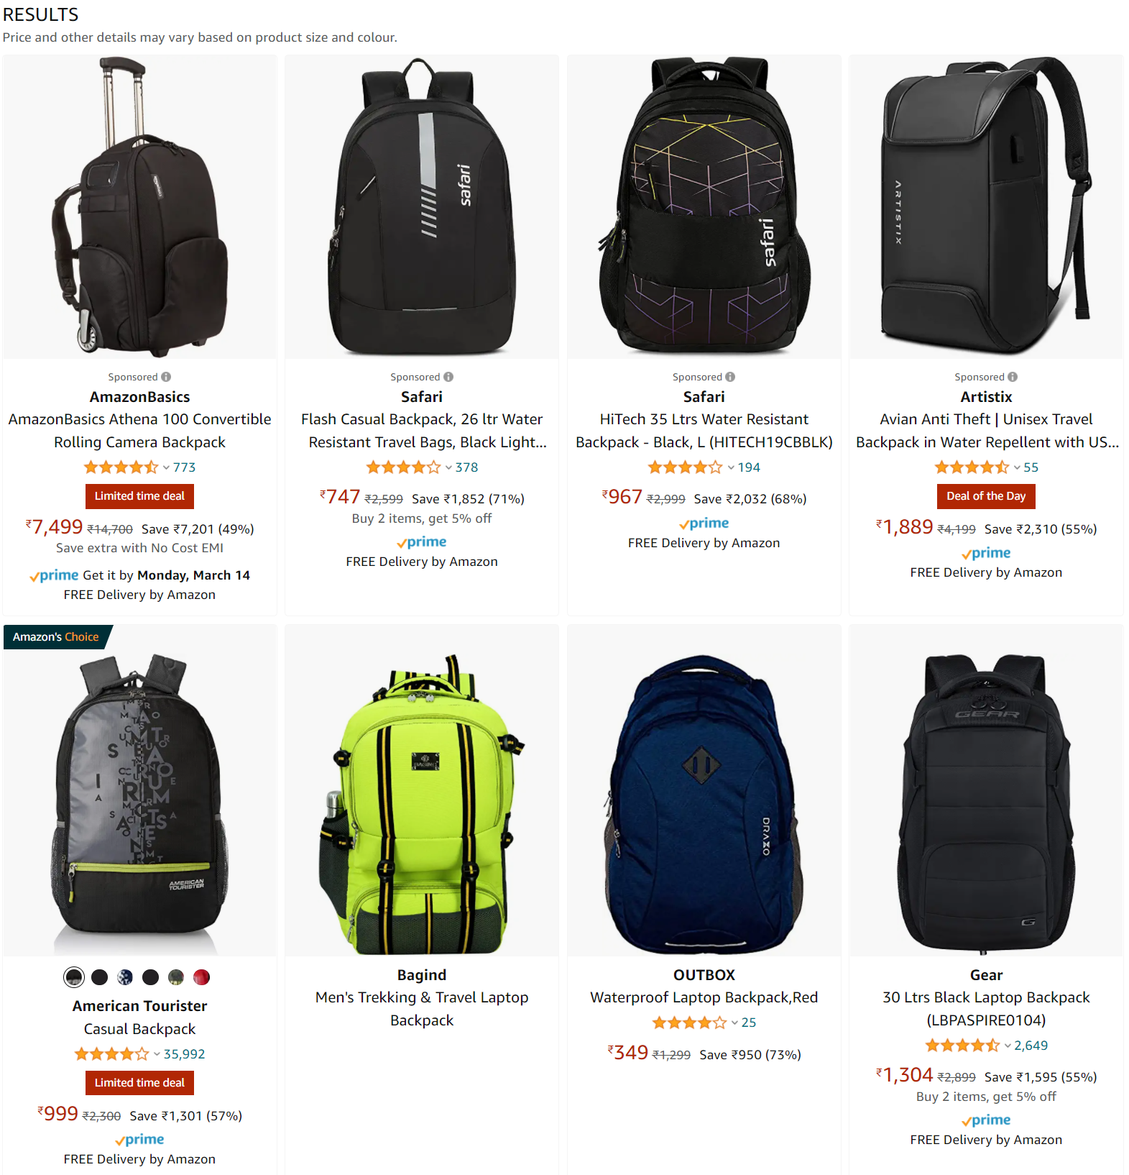
Importance
Mostly Sponsored results replacing organic results
Sponsored results offer a powerful option to nudge customers.
Sponsored
Organic

Slide 5
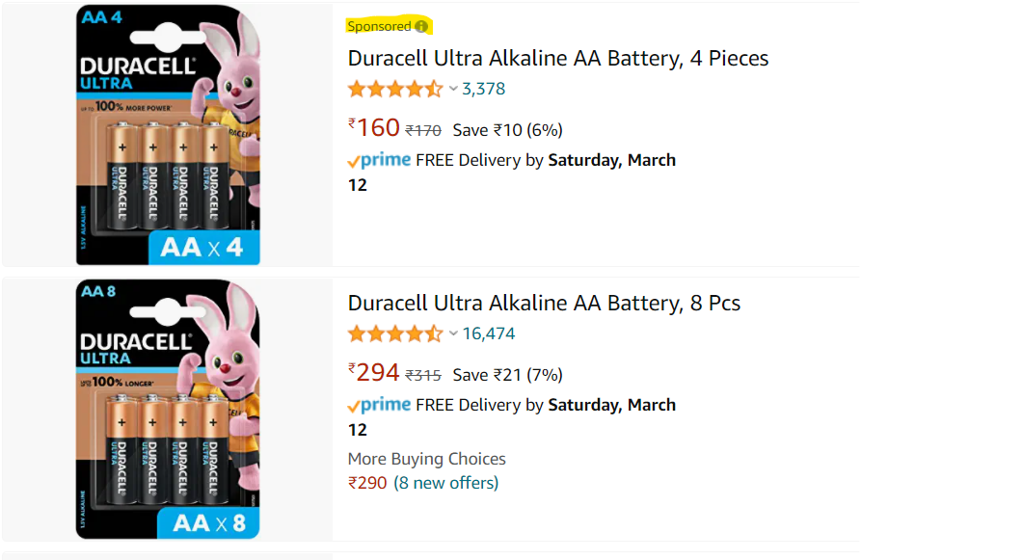
Search Mechanism on Amazon
Search: Customers search for specific items they are aware of
Results:
Grid wise, Row wise.
Sponsored Results vs Organic Results.
Sponsored advertisements are interleaved between organic search results.
*Screenshot taken from Amazon.in.
*Image showing Row wise search result.

Slide 6
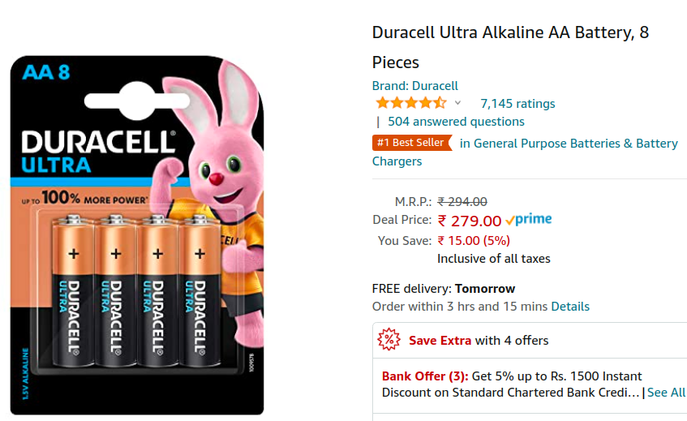
Third party products (3P)
Many products from different 3P brands are sold on Amazon e.g., Duracell.

Slide 7
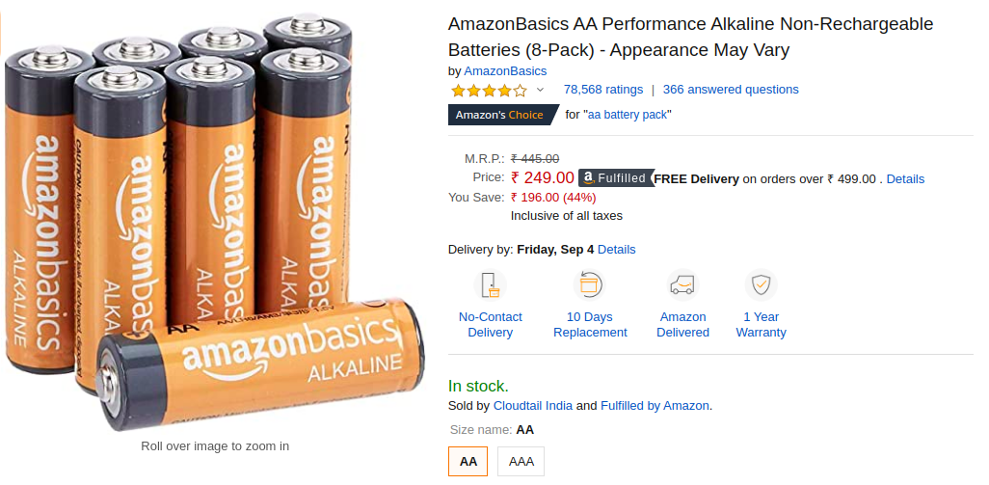
Third party products (3P) Vs. Amazon private labels (PL)
Amazon also produces its own PL products under brand names e.g., AmazonBasics.
Many products from different 3P brands are sold on Amazon e.g., Duracell.

Slide 8
Methods (Phase 1)
Data Collection
Wall Clock, Washing Machine
Toilet Paper, USB Cable
Tissue Paper, Monitor Stand
HDMI Cable, Vegetable Chopper
Backpack, Battery
We crawled the Amazon website for data collection (Collected 10 Days data).
The recommendations and metadata for each products were collected.
Both Organic, Sponsored, Private Labels(PLs) , Special Merchant(SMs) products were collected.

Slide 9
Data Collection Process
Grid Wise and Column Wise Crawler.
Attributes Crawled ‘DESCRIPTION’, ‘BRAND’, ‘RATINGS’, ‘SPONSORED’, ‘AMAZON'S CHOICE’, ‘SELLER NAME’ etc.
Considered Private Labels 'Pinzon', 'AmazonBasics', 'Solimo', 'Amazon Elements', 'Wag', 'Mama Bear', 'Presto!', 'Wickedly Prime', '365', 'AmazonFresh', 'Happy Belly', 'Vedaka', 'Mae', 'Goodthreads', '206 Collective', 'Amazon Essentials', 'Core 10', 'Amazon Brand - Solimo’
Considered Special Merchant 'Cloudtail India', 'Appario Retail Private Ltd’

Slide 10
Methods (Phase 2)
Empirical Analysis
What fraction of products are Amazon Private Labels/Special Merchants among all a) Sponsored Results, b) Organic Results, and c) Sponsored + Organic results ?
Highlight the positions where Amazon Private Labels/Special Merchants appear ? (For SERP 1 of the products)
(Temporal) Distribution of results and highlighting the cells ? (For SERP 1 of the products)
Verification of Amazon Claim “Only 2-3 percent of the ad space is occupied by Private Labels” ?

Slide 11
Empirical Analysis [1.1]
Sample Fractions of Sponsored, Organic and total Percentage for Private Label and Special Merchants (Captured on 28.02.2022)
2. This is snapshot of 4 products.
3. Whole results can be found here.
Product | PRIVATE LABEL |  |  | SPECIAL MERCHANTS
 | Sponsored | Organic | Total | Sponsored | Organic | Total
Toilet Paper | 0.25 | 0.083334 | 0.11667 | 0.83334 | 0.4 | 0.4912
USB Cable | 0.5 | 0 | 0.1363 | 1 | 0.9375 | 0.9545
Wall Clock | 0.0833 | 0.0208 | 0.033 | 0.083 | 0.1276 | 0.1186
Washing Machine | 0.1666 | 0 | 0.045 | 0.666 | 0.1875 | 0.3181

Slide 12
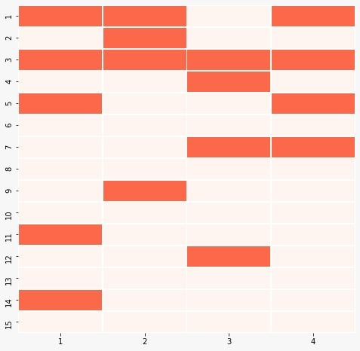
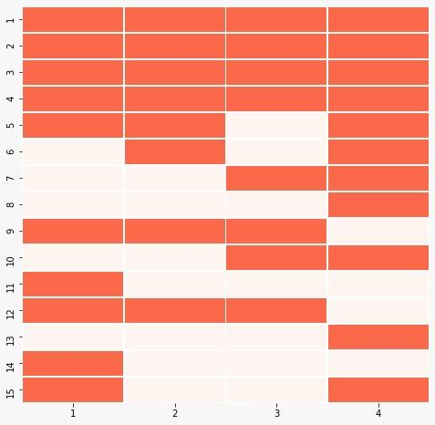
Empirical Analysis (Cont.) [1.2]
Sample GRID representation of Private Labels for Tissue Paper
Sample GRID representation of Special Merchants for Tissue Paper
GRID Representation of Private labels
GRID Representation of Special Merchants

Slide 13
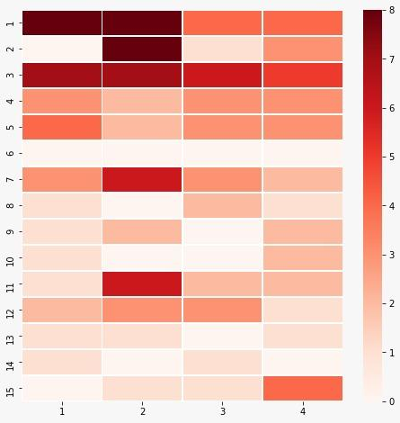
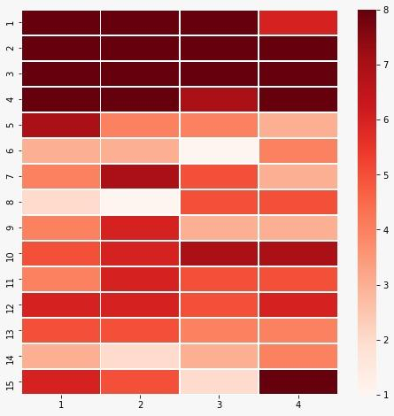
Empirical Analysis (Grid Wise) [1.3]
GRID Representation of Private labels Tissue Paper
GRID Representation of Special Merchants Tissue Paper

Slide 14
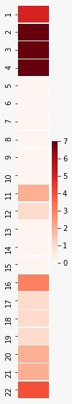
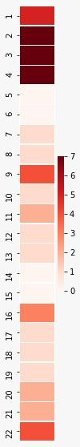
Empirical Analysis (Row Wise) [1.3]
Sample GRID representation of Private Labels for Monitor Stand
Sample GRID representation of Special Merchants for Monitor Stand
Row Representation of Private labels
Row Representation of SM labels

Slide 15
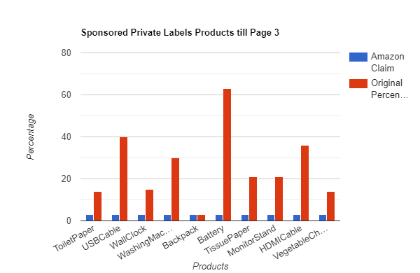
Empirical Analysis [1.4]
“Amazon claims that only 2-3 percent of the ad space is occupied by Private Labels”*
Percentage of Mean of Temporal Sponsored Private Label Products till SERP 3
*Taken from Link (Point 44)

Slide 16
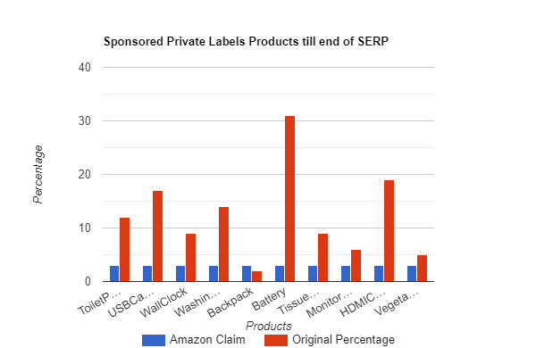
Empirical Analysis (Cont.) [1.4]
“Amazon claims that only 2-3 percent of the ad space is occupied by Private Labels”*
Percentage of Mean of Temporal Sponsored Private Label Products till end of SERP
*Taken from Link (Point 44)

Slide 17
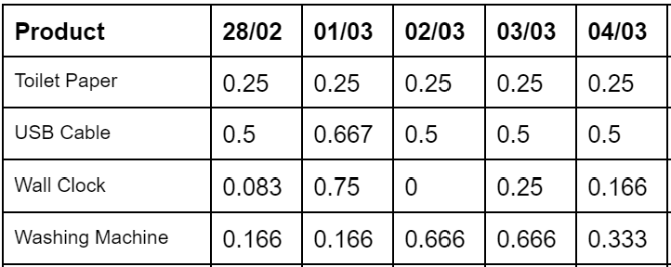
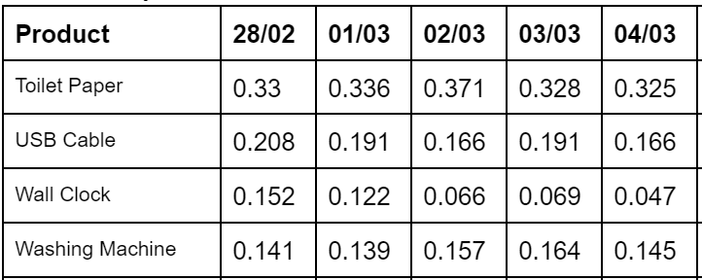
Empirical Analysis (Cont.) [1.5]
(a)SPL Products Till Page 1
“Amazon claims that only 2-3 percent of the ad space is occupied by Private Labels”
1. Sample Captured for consecutive 5 days. Taken the sponsored private label product and as per observation on 28/02, ‘Toilet paper’ SPL was seen .25% on the first page.
2. Sample Captured for consecutive 5 days. Taken the sponsored private label product and as per observation for overall result on the same day and found ‘Toilet paper’ SPL was seen .33% on SERP result.
(b)SPL Products Till End

Slide 18
Recap (Implication)
Implications on Producer
Sponsored Advertisements Replacing Organic recommendations.
Validation of more than 2-3 percent of the ad space is occupied by Private Labels.
Exposure of top brands and sellers.
Implications on Customer
How good or bad the private label products?
Customer Survey and Analysis on preference of products.
Do customer prefer sponsored more?
Midterm Presentation

Slide 19
Exposure of Top Brands and Sellers
Given Organic attention and Observed attention.
Popular geometric attention distribution
model to quantify the attention at each position.
Considered p value: 0.35
Observed Exposure and Organic Exposure.
It has been observed that through sponsored ads exposure of Private Labels/ Special Merchants increased significantly.
Probability of clicking an item is p.
Attention of a product ranked in ith position is:
for all available ranks
Ref: When the Umpire is also a Player: Bias in Private Label Product Recommendations on E-commerce Marketplaces

Slide 20
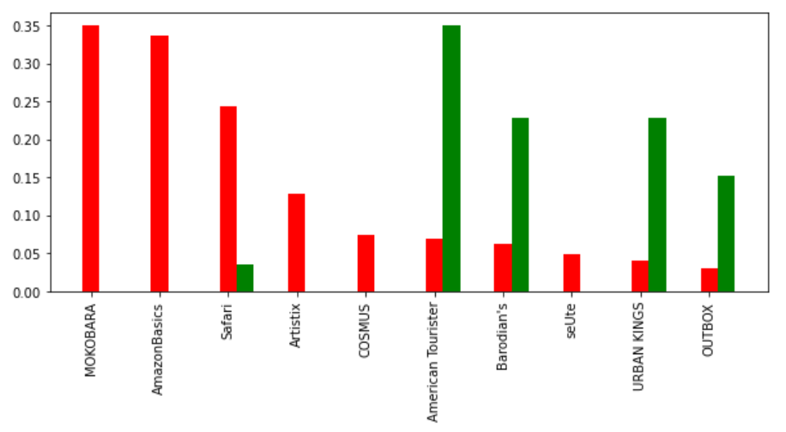
Exposure of Backpack
Red bar signifies Observed exposure and green bar signifies organic exposure
Brand

Slide 21
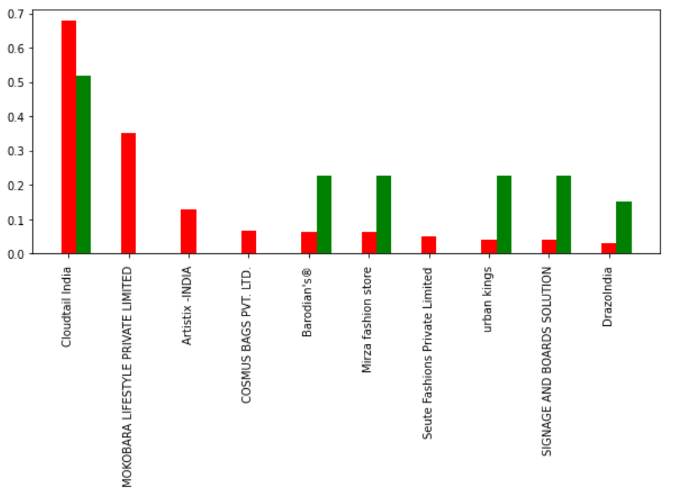
Exposure of Backpack
Red bar signifies Observed exposure and green bar signifies organic exposure
Brand
Seller

Slide 22
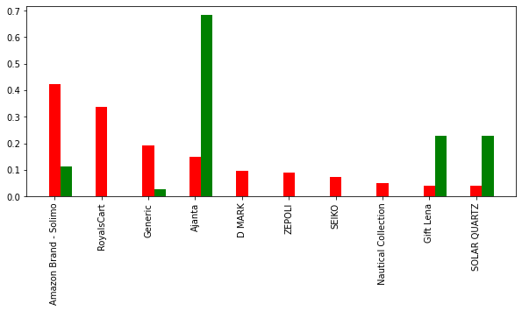
Exposure of Wall Clock
Red bar signifies Observed exposure and green bar signifies organic exposure
Brand

Slide 23
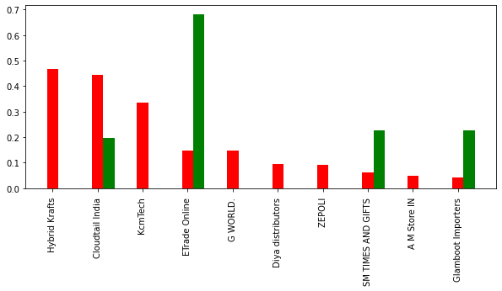
Exposure of Wall Clock
Red bar signifies Observed exposure and green bar signifies organic exposure
Brand
Seller

Slide 24
Products Good or Bad?
Finding organic position at which the sponsored products appear.
Check the average user rating and number of ratings of these products
How good / bad are they as compared to the organic results that appear on the first SERP?
Distribution of the price, avg rating, number of rating of the products in sponsored results and organic list.
Compare distributions and check student t-test for significance.

Slide 25
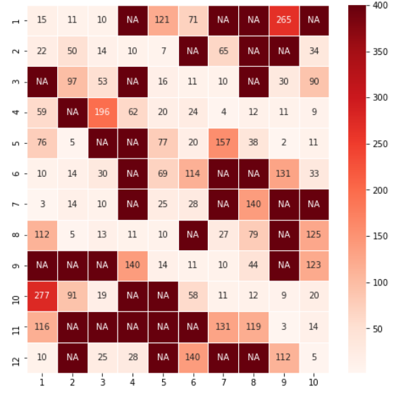
Organic Positions of Sponsored Products
Vegetable Chopper

Slide 26
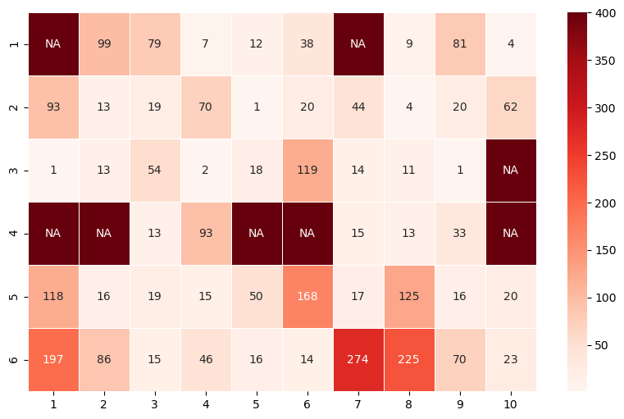
Organic Positions of Sponsored Products
Vegetable Chopper
Washing Machine

Slide 27
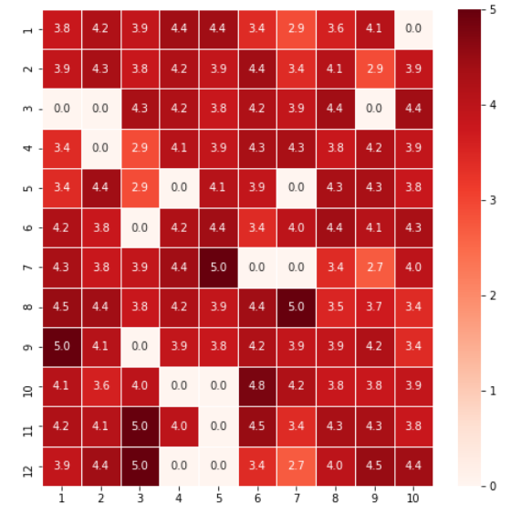
Average User Ratings of Sponsored Products
Vegetable Chopper

Slide 28
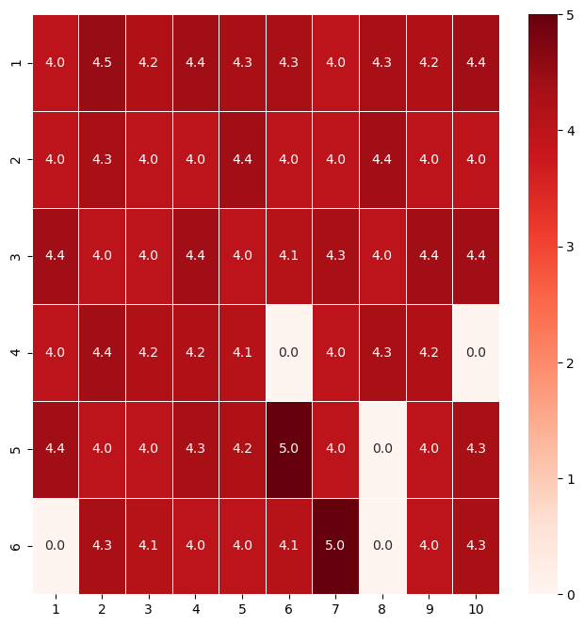
Average User Ratings of Sponsored Products
Vegetable Chopper
Washing Machine

Slide 29
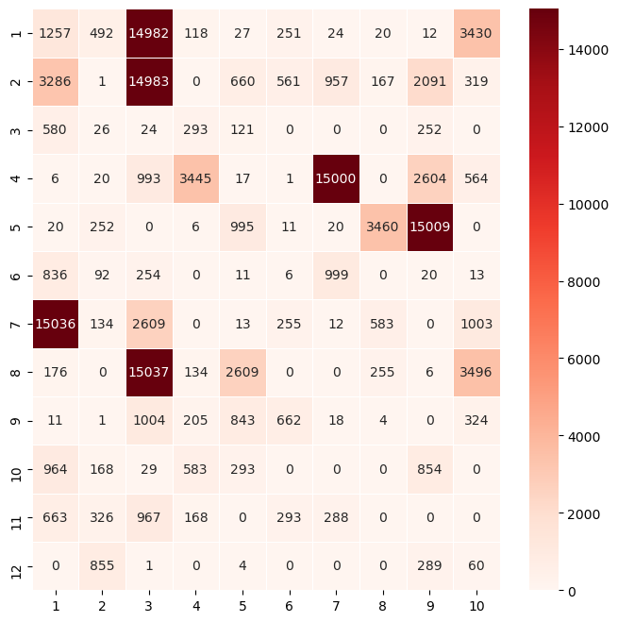
Number of Ratings of Sponsored Products
Wall Clock

Slide 30
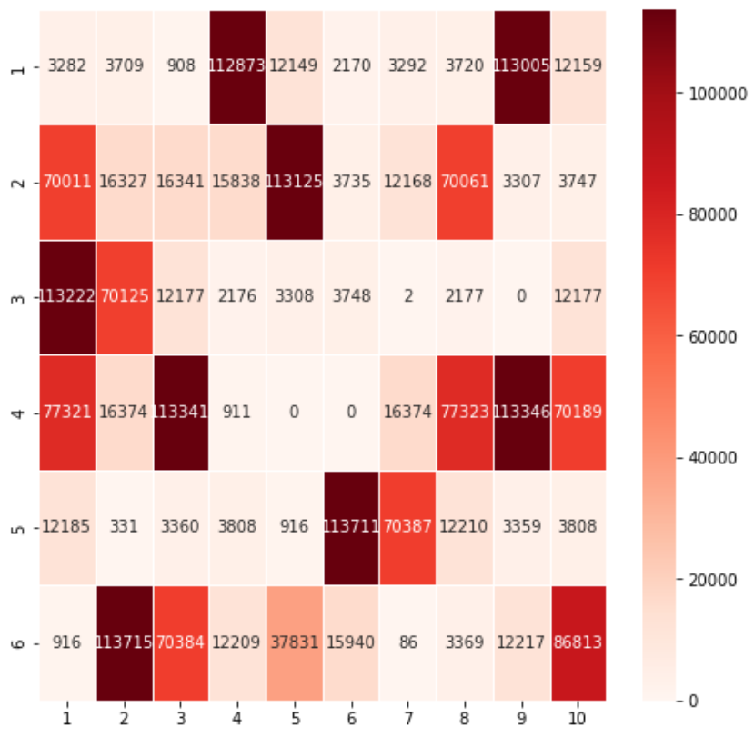
Number of Ratings of Sponsored Products
Wall Clock
Battery

Slide 31
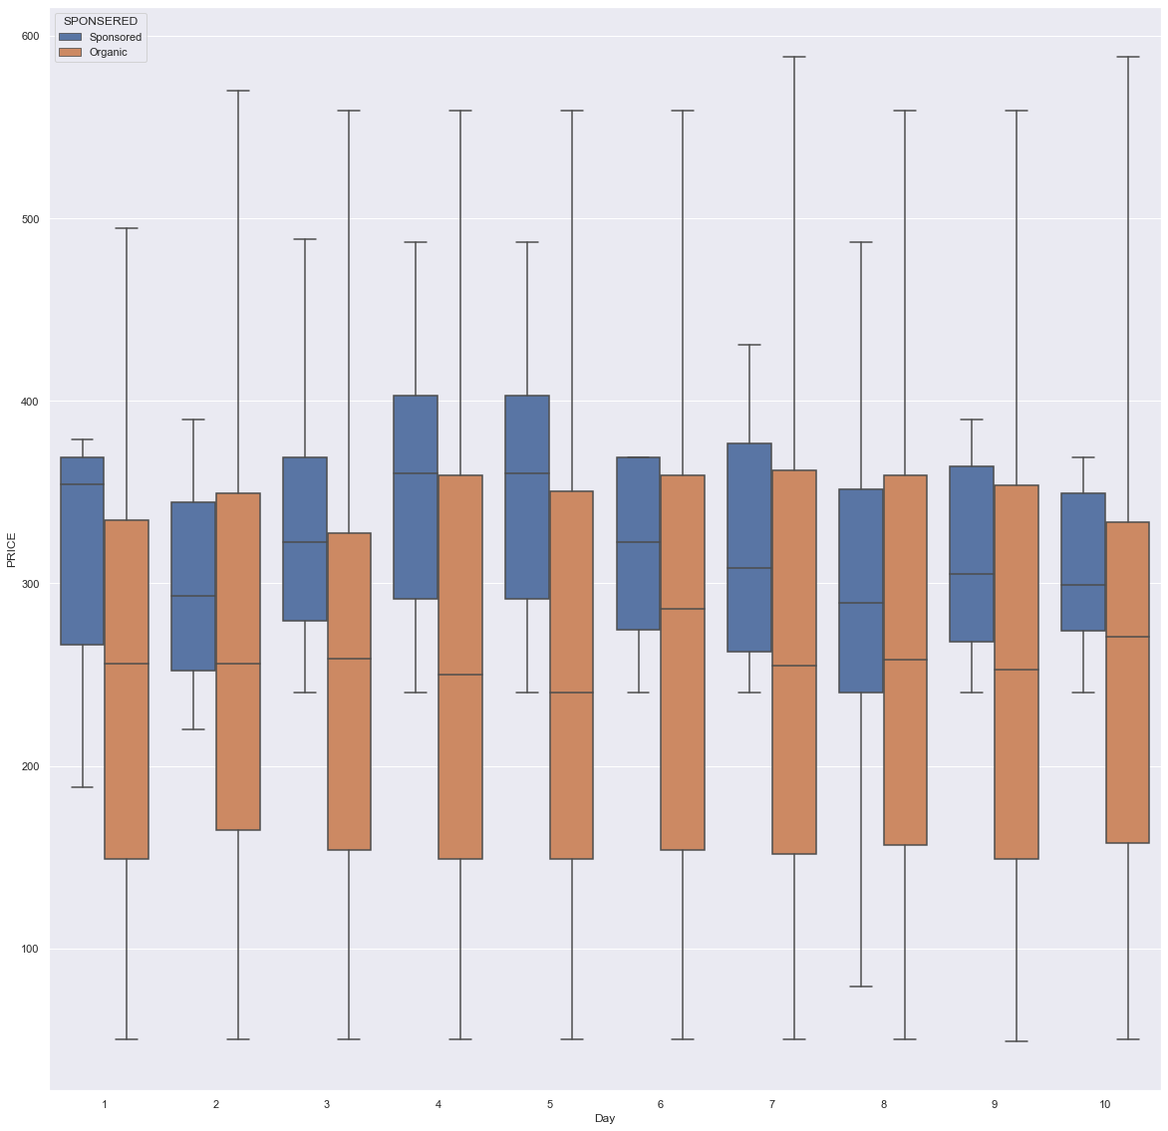
Box Plot Distribution
The BOX PLOT Price distribution for 10 days is shown. Blue boxes are for sponsored items and Orange are for Organic products.
Tissue Paper

Slide 32
Trend on Box Plot Distribution
Sponsored median is ________ than Organic median
Products | Price | Rating | Review
Toilet Paper | Higher(8/10) | Equal(8/10) | Higher(10/10)
USB Cable | Higher(10/10) | Higher(6/10) | Higher(10/10)
Wall Clock | Higher(10/10) | Higher(7/10) | Lesser(8/10)
Full Result

Slide 33
Take away from Box Plot
For similar quality products, customers have to pay a higher price for sponsored products and this trends continues for all 10 products for which we have done the analysis.
In most cases the gaps between mean price is statistically significant.

Slide 34
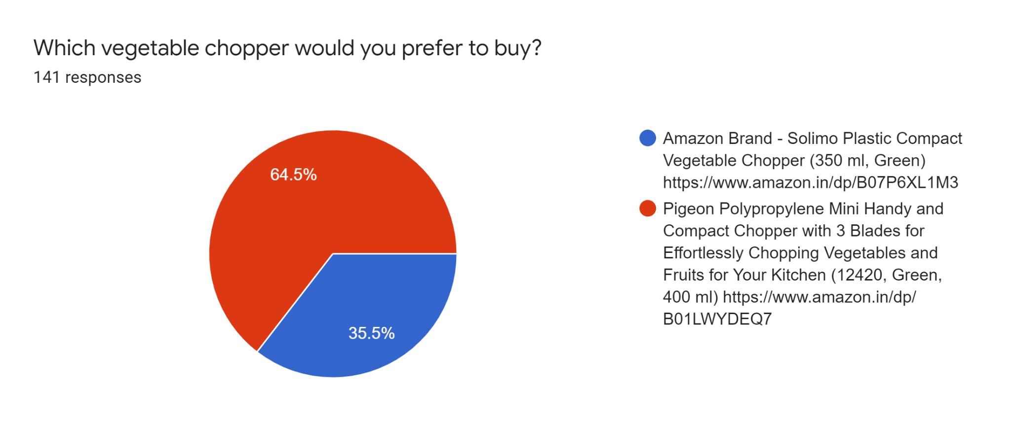
Customer Survey

Slide 35
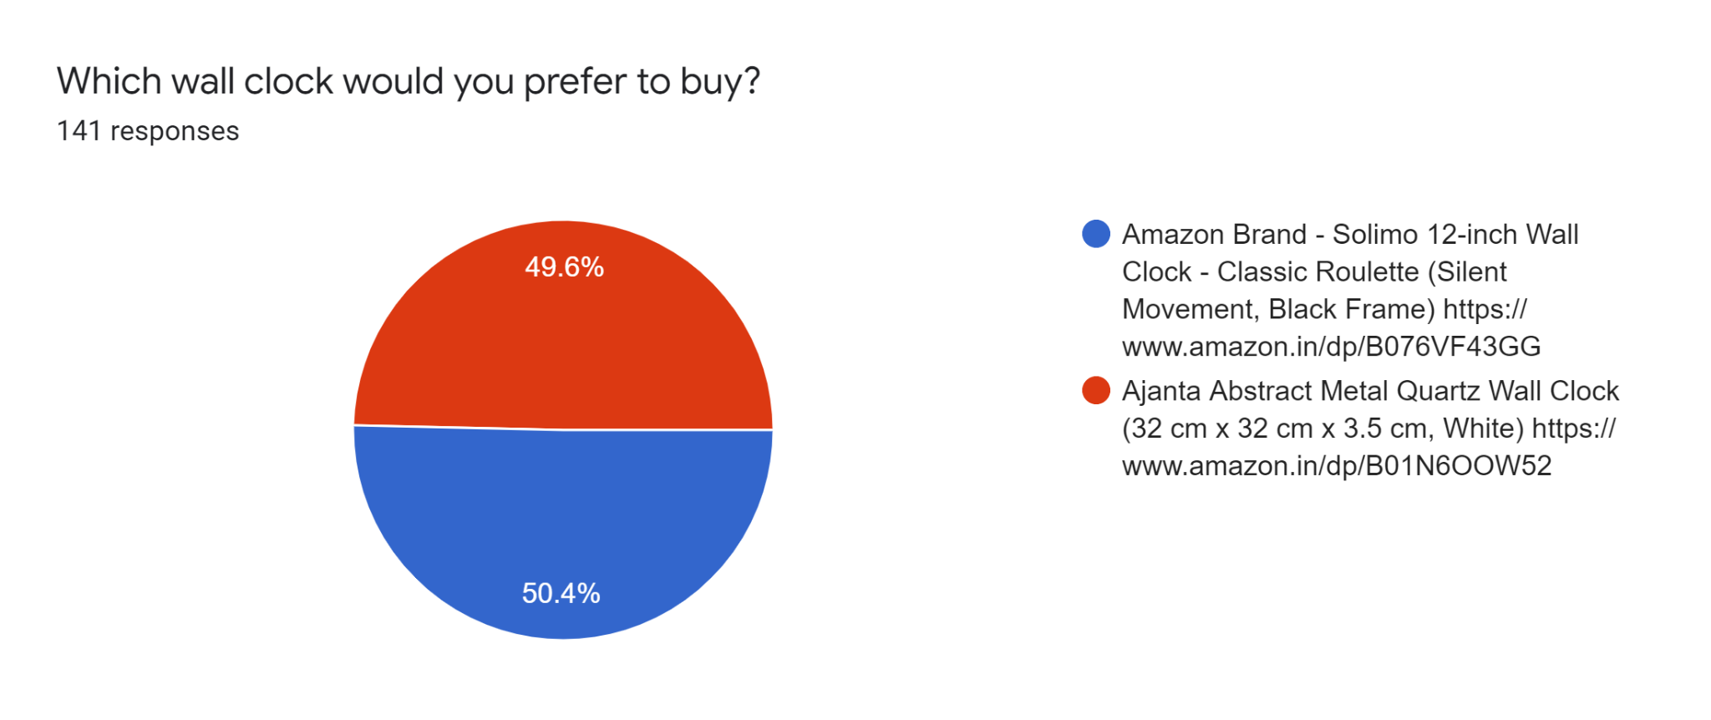
Customer Survey Cont.

Slide 36
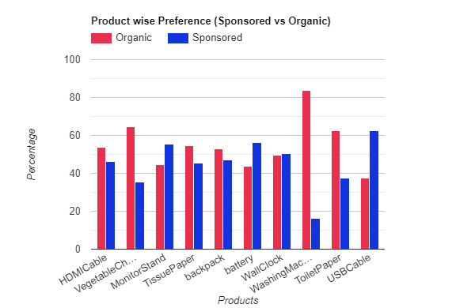
Customer Survey Agg. statistics
Total survey response 141.
All products wise break up.

Slide 37
Thank You

